Slide 1



Evaluation of drought tolerance in relationship to climate change in Southwestern White Pine (Pinus strobiformis)
Briana Palmiero
Mentor: Dr. Amy Whipple
Northern Arizona University

Slide 2
Purpose and Importance
…to determine whether climate warming will negatively affect Southwestern white pine
Wildlife food sources
Habitat for birds and small mammals
Soil erosion mitigation
Biodiversity
Air quality

Slide 3
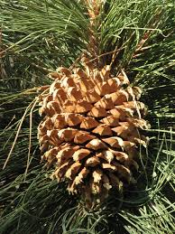
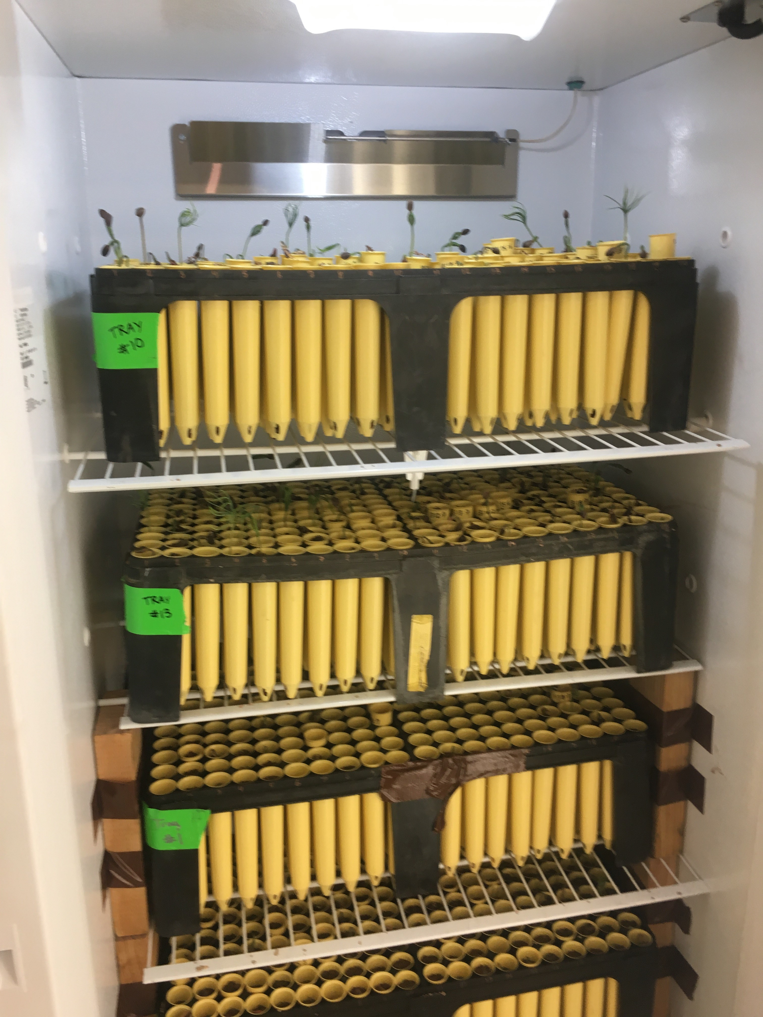
Experimental Design
1) Seed Warming
2) Seedling Growth

Slide 4
Hypotheses
bagging treatment during germination will not have an affect on seedling hydraulics, and
the different chamber temperatures will influence seedling hydraulics, with the warmest chamber having the greatest effect.

Slide 5
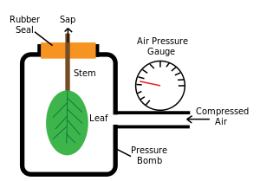
Methods
Seedlings were cut at the stem
Pressure was applied to the foliage and gradually increased
When enough pressure was exerted water emerged from stem, and that pressure was recorded
Growth chamber data, seed source, and warmed versus control treatments were combined and compared to recorded pressure
Linear mixed models were used in R to test for patterns in our data
Patterns were interpreted in light of my hypotheses
Source: Scholander Pressure Bomb

Slide 6
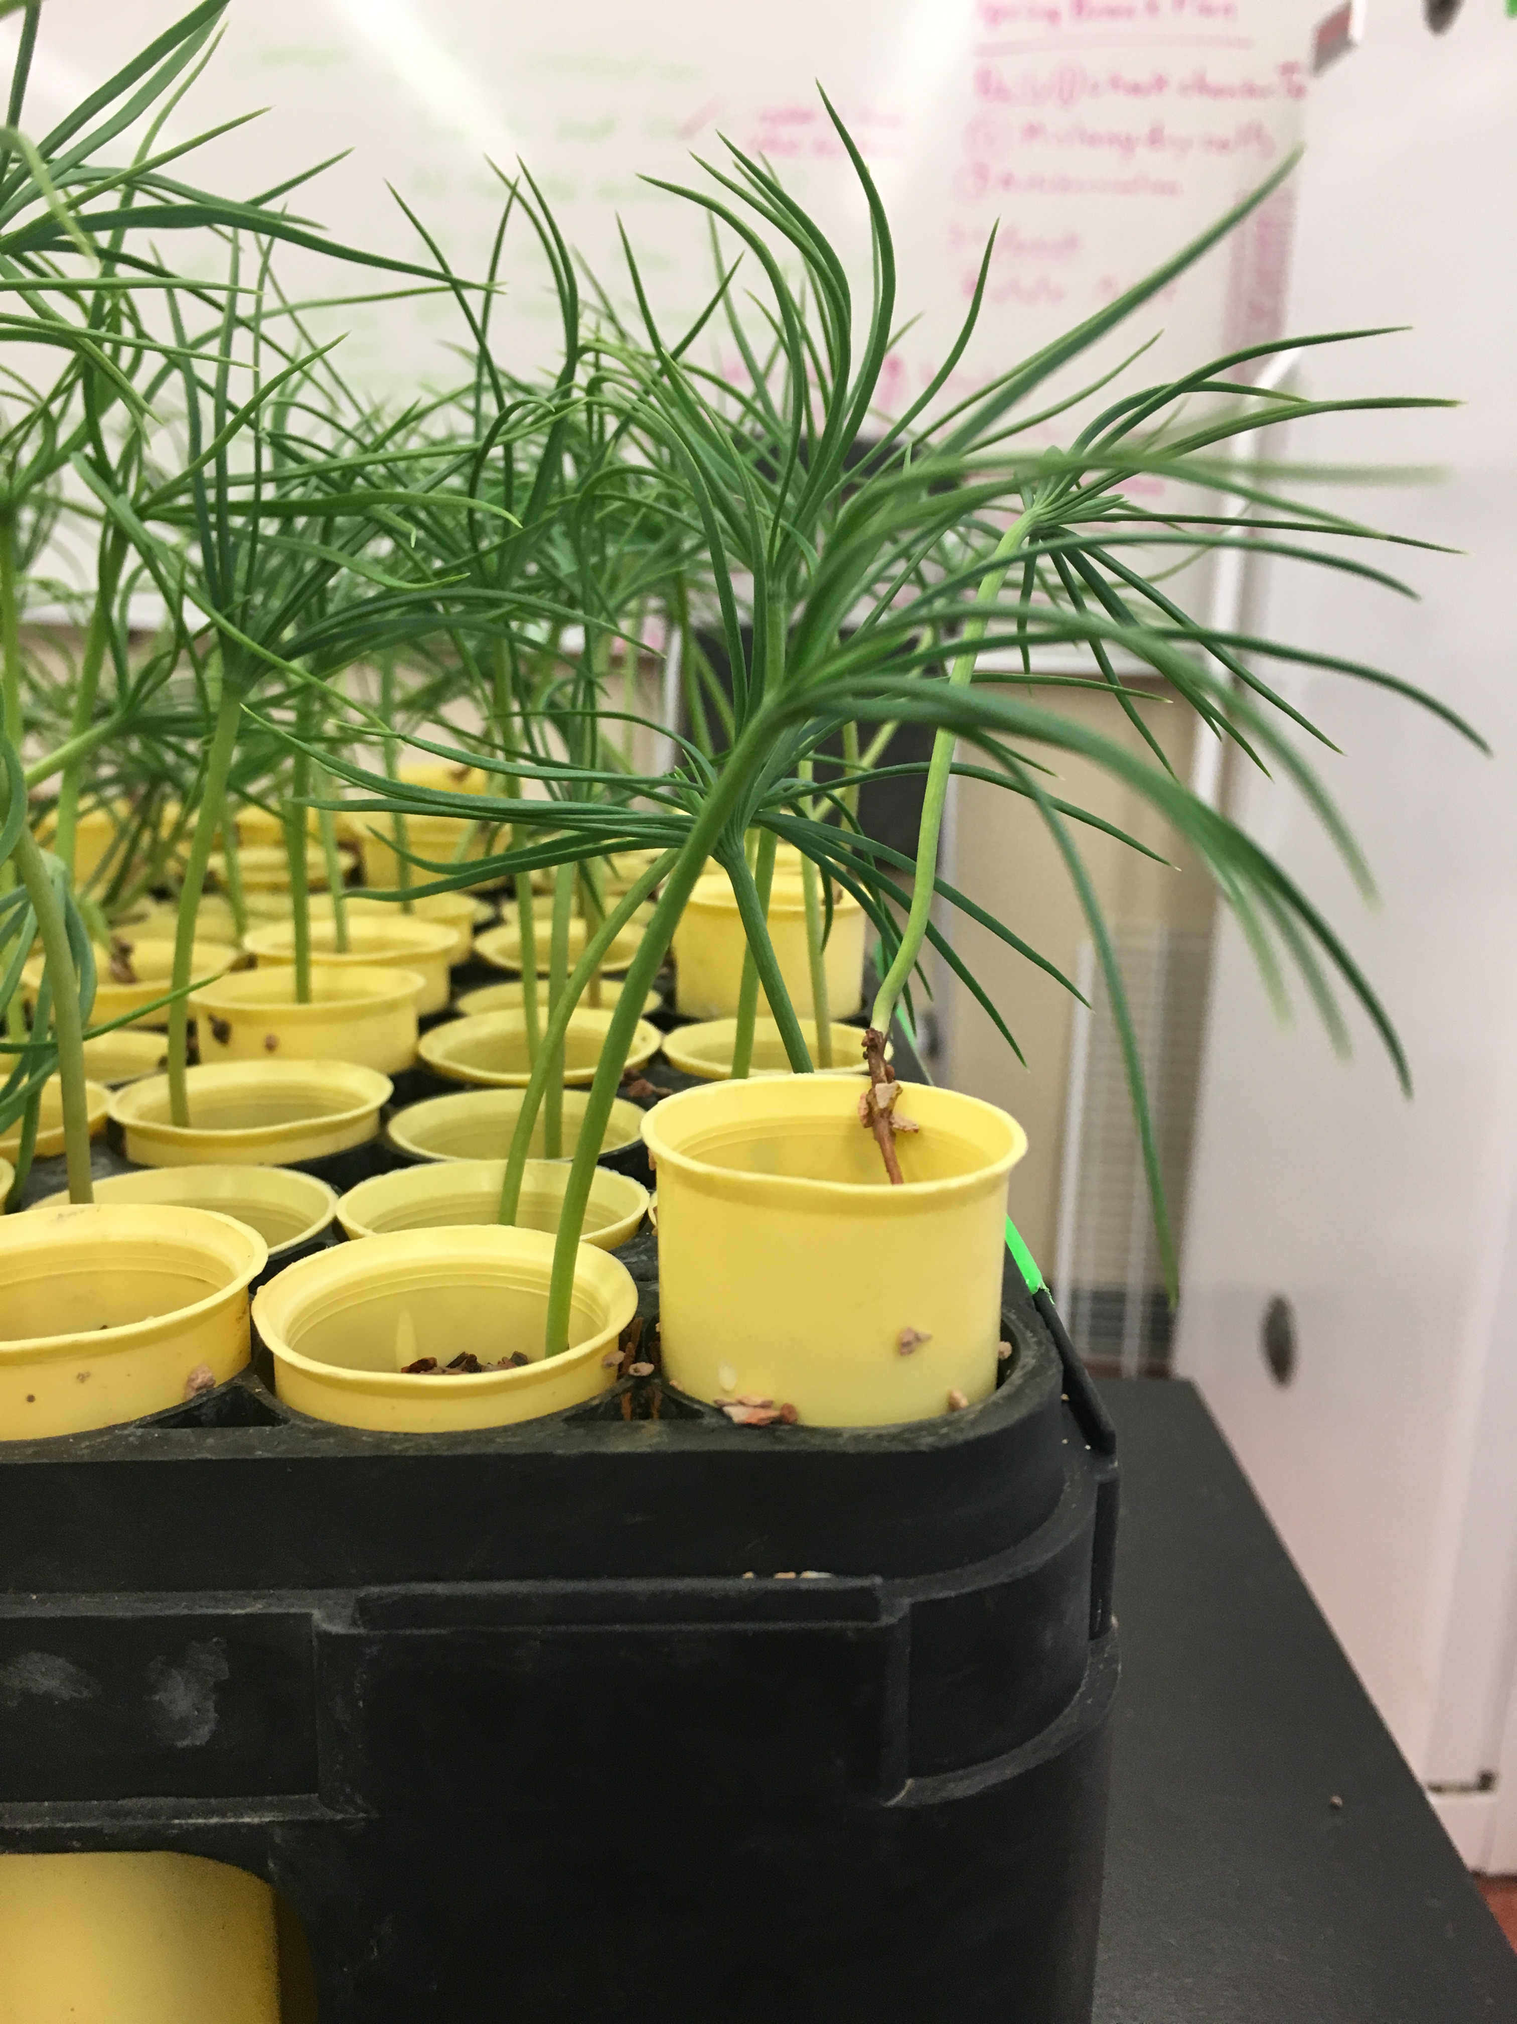

What exactly are we measuring?
Transpiration
Leaf Level
Hydraulic Conductance
Entire Seedling

Slide 7
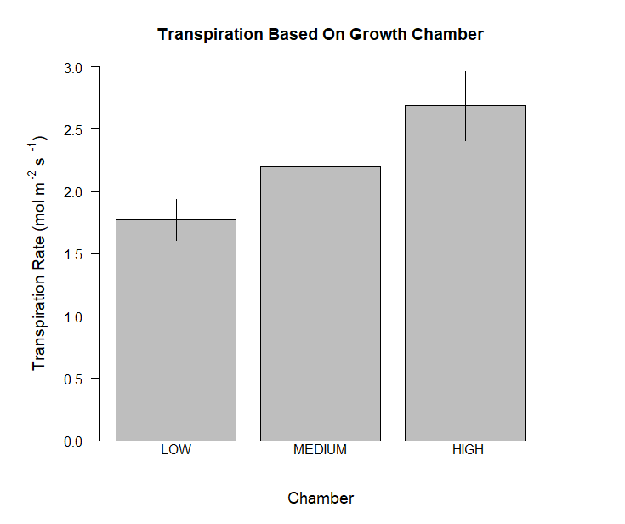
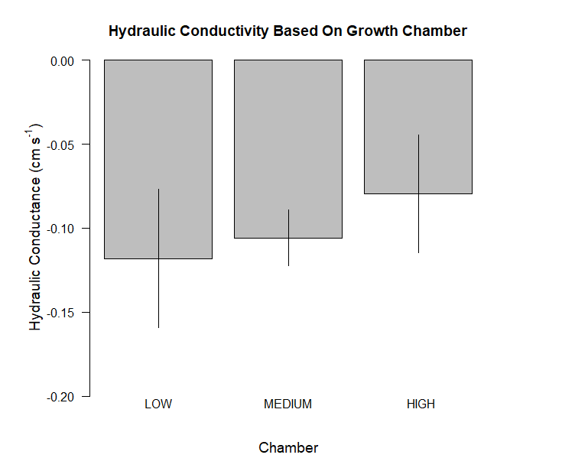
Results

Slide 8
Discussion
Temperature increases transpiration and productivity
Capture more carbon
Potential to acclimate

Slide 9

Acknowledgements
My mentor Dr. Amy Whipple for her advice and resources and the many hours she spent reviewing my work.
Our graduate students Ehren Moler and Jarred Swenson for help with data analysis, developing experiments, and training.
All other undergraduate students in the Whipple lab for lending me a hand when needed.
NAU NASA Space Grant
Hooper Undergraduate Research Award

Slide 10

Thank You!

